Slide 1

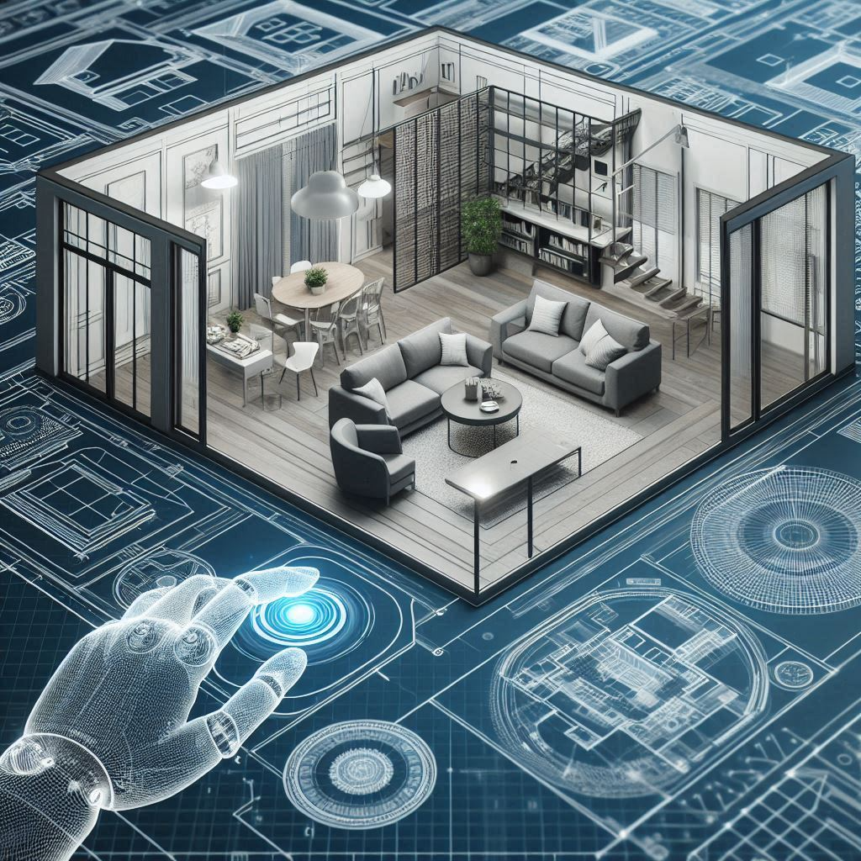
Home automation using gesture RECOGNITION for disabled person

Slide 2
TEAM MEMBERS:
SABARI PRIYAN G (811721243044)
NAVEEN KUMAR K (811721243037)
NEELA MUGESH S (811721243039)
SHAI SHARATH VIJEY S (811721243050)
GUIDED BY:
Mrs.G.NALINA KEERTHANA M.E.,

Slide 3
OBJECTIVE:
Develop a cost-effective home automation system for disabled individuals, integrating Android, PIC microcontroller, Bluetooth, and enhancing accessibility.

Slide 4
PROPOSED SYSTEM:
Gesture recognition algorithm for accurate interpretation.
Wireless communication for seamless device control.
Integration with home automation appliances and devices.

Slide 5
LITERATURE SURVEY
S.NO | PAPER TITLE | AUTHOR | PUBLISHED YEAR | TECHNIQUE USED | MERITS | DEMERITS
1. | Literature Review on Home Automation System for Physically Disabled People | Saeed Faroom, Muhammad Nauman Ali, Sheraz Yousaf | 2018 | 1.Voice Control 2.Gesture Recognition 3.Brain-Computer Interface (BCI) 4.Sensor Networks | Accessibility Intuitive Directness Adaptability | Accuracy Complexity Training Time Maintenance
2. | Eye Movement Based Cursor Control and Home Automation for Disabled People | Sharon Mathew, Sreeshma A, Theresa Anitta Jaison, Varsha Pradeep | 2019 | 1.Eye Tracking 2.Speech Recognition 3.Brain-Computer Interface (BCI) 4.Sensor Networks | Precision Accessibility Direct Control Adaptability | Fatigue Accuracy Complex Setup Compatibility

Slide 6
S.NO | PAPER TITLE | AUTHOR | PUBLISHED YEAR | TECHNIQUE USED | MERITS | DEMERITS
3. | IoT Based Sign Language Recognition System | Punsara K.K.T, Premachandra H.H.R.C, Chanaka A.W.A.D, Wijayawickrama R.V. | 2020 | Convolutional Neural Network(CNN) | Accuracy Feature Learning Scalability improve performance Real-time Processing | Complexity Overfitting Data Dependency Hardware Requirements
4. | Android Home Automation using PIC Microcontroller and Bluetooth | VULAVABETI RAGHUNATH REDDY,SHAIK ANUSHA , ORUGUNTI RAJESWARI,B HARI CHANDANA | 2019 | 1.Bluetooth Communication 2.PIC Microcontroller 3.Android Application Development 4.Home Automation | Wireless Versatility Customization Convenience | Security Risks Limited Memory Fragmentation Maintenance
5

Slide 7
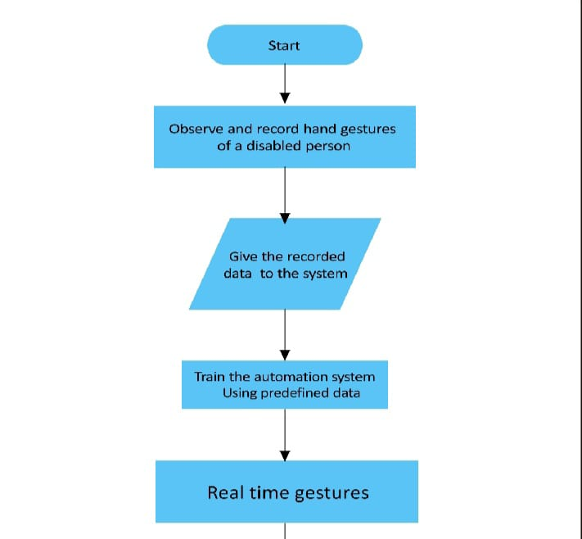
FLOWCHART

Slide 8
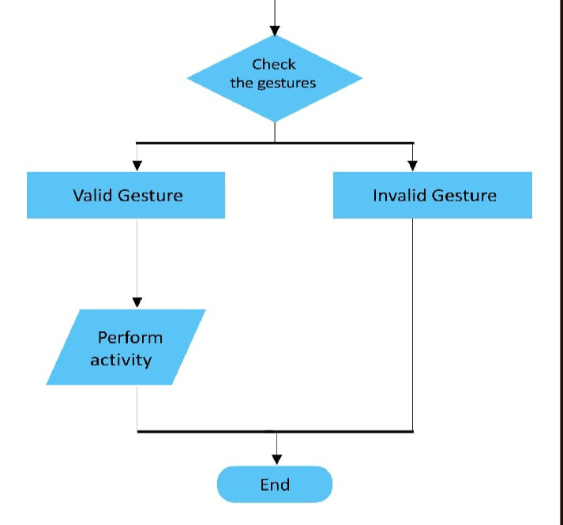

Slide 9
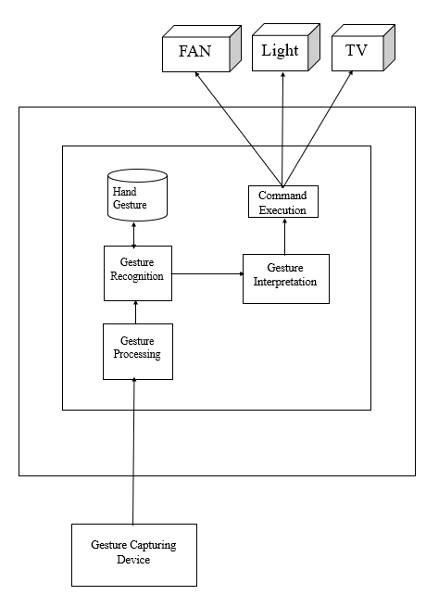
ARCHITECTURE DIAGRAM

Slide 10
SYSTEM SPECIFICATION
HARDWARE COMPONENTS:
Microcontroller/Processor (Raspberry Pi or Arduino)
Camera/Sensor(Depth camera or a simple webcam)
Relay Modules (For switching home appliances on and off)
Smart Devices (Smart bulbs, smart plugs, etc.,)
Power Supply
Networking (Wi-Fi or Bluetooth modules)
User Interface

Slide 11
SOFTWARE COMPONENTS:
Operating System (Linux-based OS for Raspberry Pi or appropriate firmware )
Gesture Recognition Software (OpenCV, TensorFlow, or other machine learning libraries)
Home Automation Software (OpenHAB, Home Assistant, or custom-built software)
Mobile App/ Web Interface

Slide 12
MODULES:
Gesture Capture Module
Gesture Recognition Module
Command Processing Module
Device Control Module
Feedback and Monitoring Module
Configuration and Setup Module

Slide 13
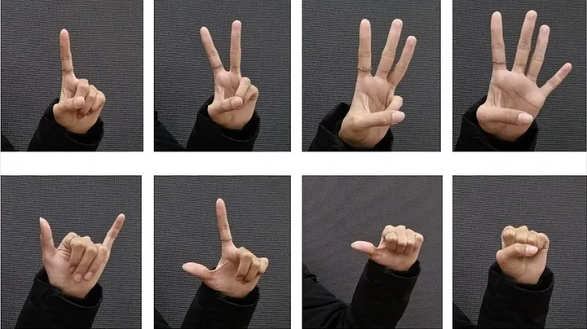
GESTURE CAPTURE MODULE:
Function: Captures hand or body gestures using a camera.
Components: Camera (webcam or depth camera), microcontroller/processor.
Software: OpenCV for image processing, TensorFlow for gesture recognition models.
Explanation: The camera captures real-time video, and the software processes these images to detect specific gestures. Pre-trained machine learning models classify these gestures into predefined commands.

Slide 14
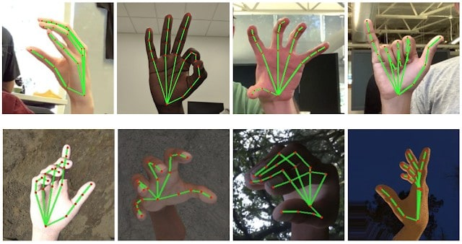
GESTURE RECOGNITION MODULE:
Function: Processes captured gestures and translates them into commands.
Components: Processor with sufficient computational power.
Software: Machine learning libraries like TensorFlow or Keras.
Explanation: This module uses algorithms to analyze the captured gestures. It maps recognized gestures to specific control commands for home automation tasks.

Slide 15
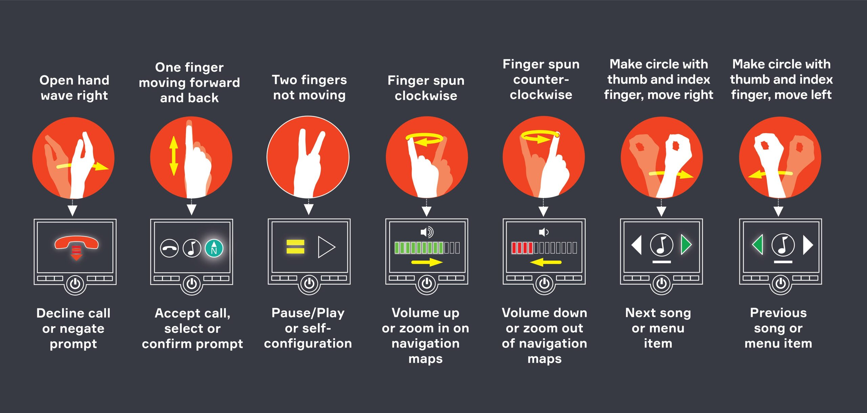
COMMAND PROCESSING MODULE:
Function: Interprets the recognized gestures and triggers appropriate actions.
Components: Microcontroller/processor.
Software: Custom scripts or home automation software.
Explanation: Once a gesture is recognized, this module translates it into a command that the home automation system can understand. For example, a specific gesture might turn on the lights, while another might adjust the thermostat.

Slide 16
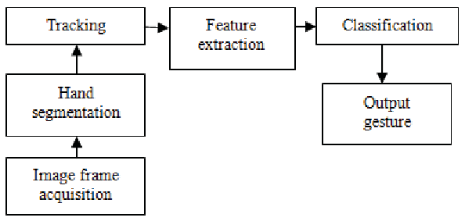
DEVICE CONTROL MODULE:
Function: Controls home devices based on processed commands.
Components: Relay modules, smart devices.
Software: Home automation software (OpenHAB, Home Assistant).
Explanation: This module sends signals to the respective home devices to perform actions like switching on/off lights, adjusting temperatures, etc. It communicates with smart devices either directly or through relay switches.

Slide 17

FEEDBACK AND MONITORING MODULE:
Function: Provides feedback to the user and monitors system status.
Components: Display screen or mobile app.
Software: Mobile app, web interface.
Explanation: This module provides real-time feedback to users, confirming actions taken or providing alerts. It allows users to monitor the status of home devices and ensure the system is functioning correctly.

Slide 18
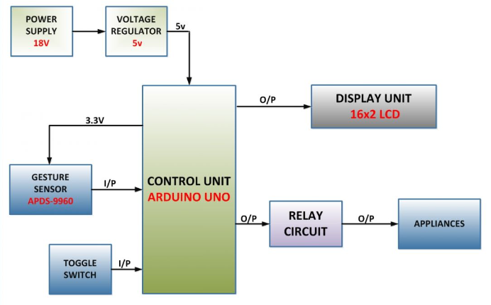
CONFIGURATION & SET-UP MODULE:
Function: Allows users to configure the system and set up gestures.
Components: User interface (mobile app or web interface).
Software: User-friendly interface software.
Explanation: This module helps users configure the system, define custom gestures, and set preferences. It ensures the system is tailored to the individual needs of the disabled user.

Slide 19
ADVANTAGES:
Simplifies tasks, enhancing overall independence.
Streamlines automation, reducing physical interaction.
Enhances accessibility, optimizing comfort and convenience.
Promotes adaptive living, fostering inclusivity and empowerment

Slide 20
CONCLUSION
Empowers disabled individuals, improving quality of life.
Integrates technology, enhancing home automation accessibility.
Facilitates independence, optimizing self-sufficiency and autonomy.
Fosters innovation, encouraging continuous improvement and solutions.

Slide 21
References:
Android Home Automation using PIC Microcontroller and Bluetooth- vulavabeti raghunath reddy, Shaik anusha, orugunti rajeswari, b hari chandana, s farhath sujana & Published in the year of IEEE 2019
Assistive System for Physically Disabled People using Gesture Recognition- Subhankar Chattoraj, Karan Vishwakarma & Published in the year of 2017
Eye Movement Based Cursor Control and Home Automation for Disabled People-Sharon Mathew, Sreeshma A, Theresa Anitta Jaison, Varsha Pradeep & Published in the year of IEEE 2019
IoT Based Sign Language Recognition System- Punsara K.K.T, Premachandra H.H.R.C & Published in the year of IEEE 2020
Literature Review on Home Automation System for Physically Disabled People- Muhammad Nauman Ali & Published in the year of IEEE 2018

Slide 22
THANK YOU

